Slide 1
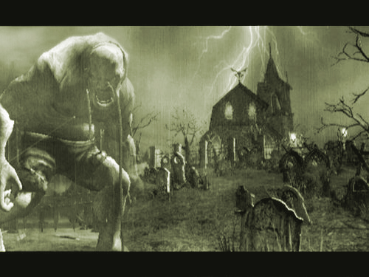
OGRE
A Game Proposal by Scott Brodie
Copyright © Scott Brodie 2005

Slide 2
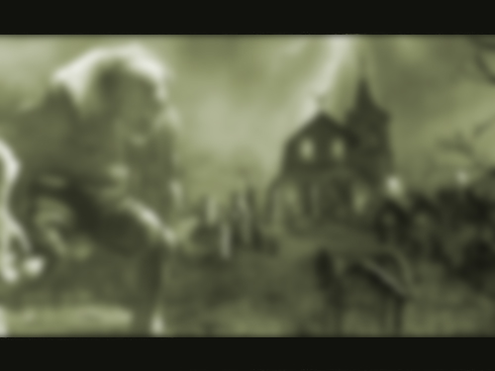
High Concept
The Vision: to create the game equivalent of the story of Beowulf and his battle with Grendel.
A multi-player, 3rd-person close-combat action game.
Play as the Ogre: a lumbering monster, imprisoned inside a gigantic, ancient temple.
OR
Play as a Hero: a legendary warrior who travels far from home to siege the temple and slay the mythical Ogre of legend to rescue the Siren inside.
Copyright © Scott Brodie 2005

Slide 3
Concept (cont’d)
Focus on a small cast of characters and story space.
Develop a play narrative through emergence provided by mechanics and environments.
Allow the players to tell the story through gameplay.
  Heroes tell of how they defeated a giant foe, while the Ogre player can describe how they were able to fend off the heroes.
Dark, moody environments, making use of dramatic lighting and level design.
Minimal UI.
Copyright © Scott Brodie 2005

Slide 4
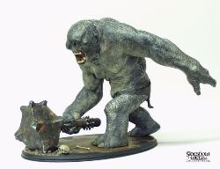
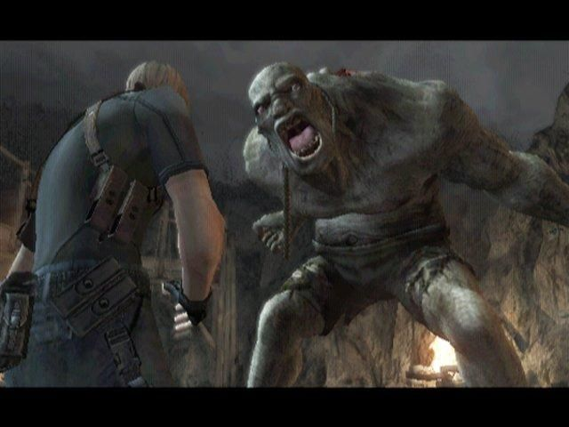
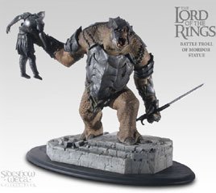
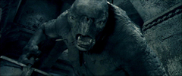
Concept Visuals
Copyright © Scott Brodie 2005

Slide 5
Gameplay Overview
Co-op heroes vs. single Ogre.
  Scalable game balancing based upon number of Heroes.
Asymmetrical game mechanics.
  Heroes chose from an assortment of weapon classes (sword, bow, throwing axes), high agility and speed.
  Ogre deals massive damage on melee attacks, however, moves slowly and restricted to insides of Temple.
Different Victory conditions
  Heroes: Defeat Ogre within time limit.
  Ogre: Survive the time limit.
Copyright © Scott Brodie 2005

Slide 6
Gameplay (cont’d)
Interactive and Destructible Environments
  Falling Rocks, breakable walls, boulders, etc.
Ogre abilities
  Huge Punch / Pound
  Roar (knocks melee attackers back)
  Grab or “Sweep” (pickup heroes and toss them)
Hero weapon choices
  Sword: most powerful / short range only
  Throwing Axes (combo): average power / average range
  Bow: least powerful / long range only
Girl / special objectives
  “Rescue the Siren”, Enchant Weapons, Ogre weak spot / attach points.
Copyright © Scott Brodie 2005

Slide 7
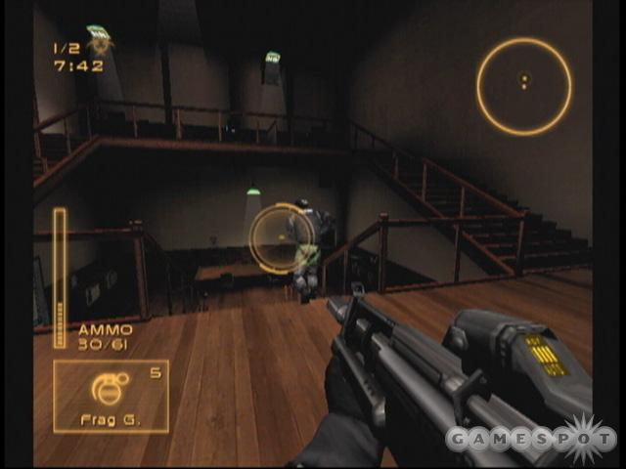
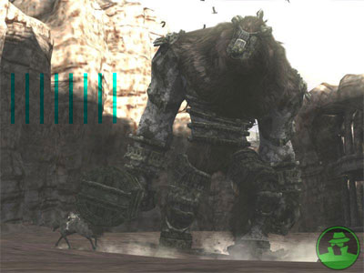
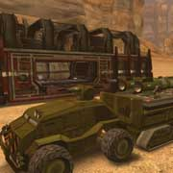
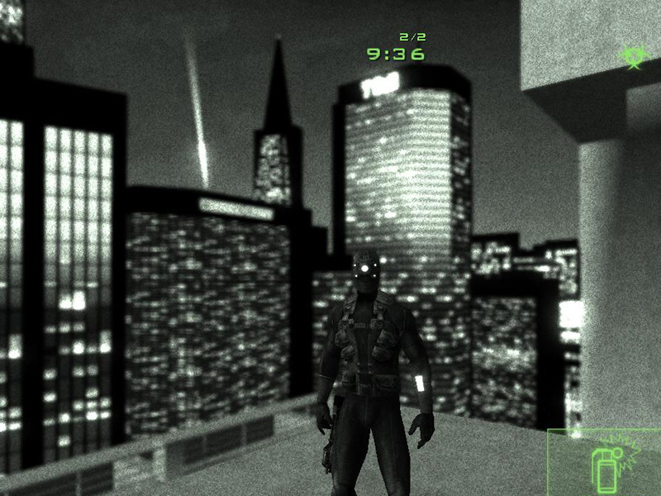
Gameplay Examples
Copyright © Scott Brodie 2005

Slide 8
Unique Selling Points
Multi-Player provides a new story every game.
Small amount of characters = greater polish time on each model.
  Same goes for level geometry.
Simple, deep, and expandable world.
  World sends heroes anywhere to battle any beast imaginable.
Lends it self to clan and user community models.
  Skill-based gameplay encourages competition.
Play as the boss!
Copyright © Scott Brodie 2005

Slide 9
Possible Concerns
Feasibility of Multi-player
  Torque specializes in this, and has most of the infrastructure setup for us.
The Ogre requires custom models, textures, and animations.
  My prime interest in this concept is working on the Ogre, and leveraging my experience building characters.
Possibly too focused?
  The lack of scope is intentional, however, gameplay lends itself to expandability.
If the Ogre is sweet, who would play as a hero?
  The primary game type will force the Ogre roll to be rotated, and an overall victor is declared after a set number of rounds.
Copyright © Scott Brodie 2005

Slide 10
“Going Big”
Optional possible features, dependent on time:
  Multiple “Ogre” types (ex: dragon)
  Death and hit animations; “rag-doll” heroes to emphasize Ogre power.
  Extra maps with different tactical advantages.
  Single player mission acting as tutorial, telling a short narrative using already created levels and assets.
  (Insert your idea here!)
Copyright © Scott Brodie 2005

Slide 11
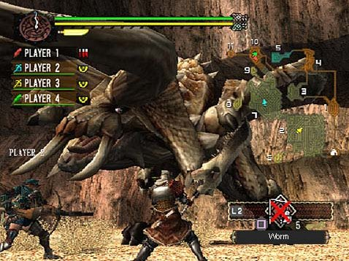
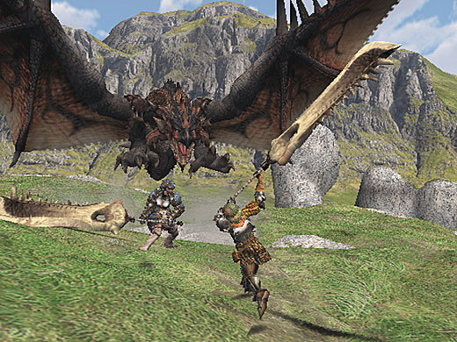
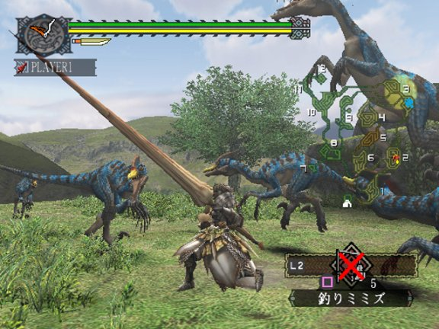
Random Inspiration
Copyright © Scott Brodie 2005

Slide 12
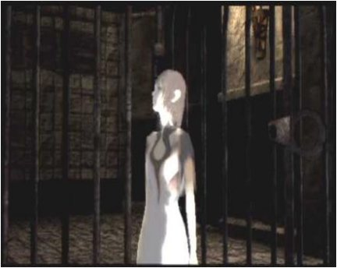
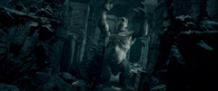
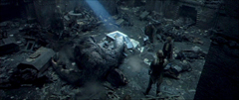
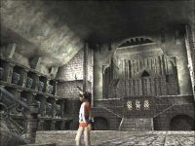
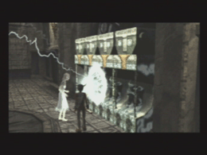
Random Inspiration
Copyright © Scott Brodie 2005

Slide 13
Questions? Ideas?
Copyright © Scott Brodie 2005

